Slide 1
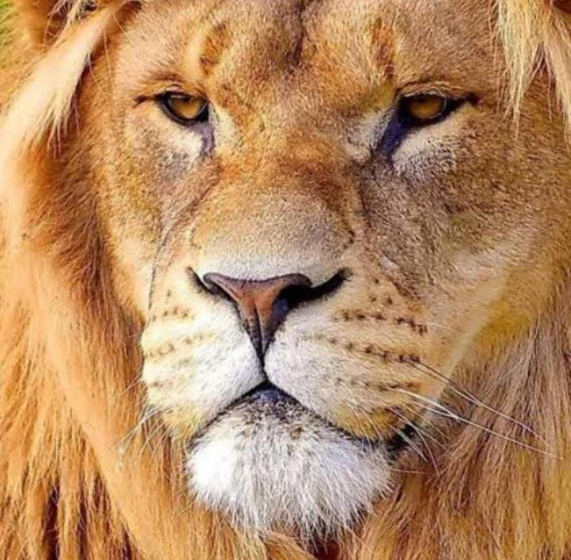
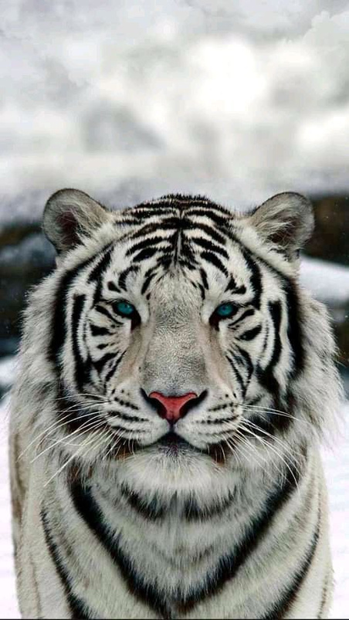

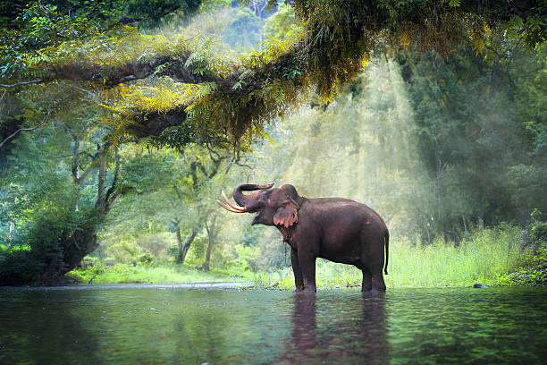
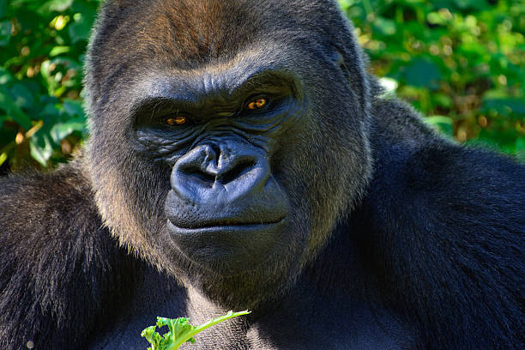
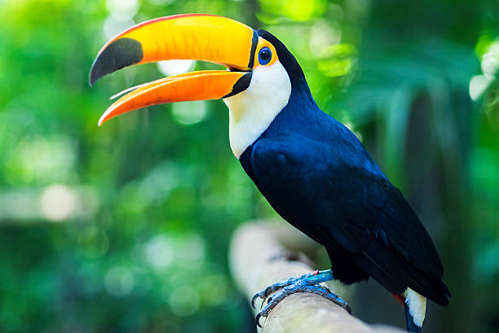
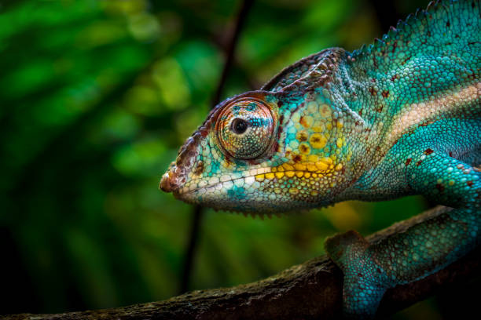
Animaux Team
AFRICAN WOMEN UNITED FOR ANIMAL RIGHTS
BY TEAM TECHNIE-PHY
AN
ANIMAL
RIGHT
MOVEMENT

Slide 2
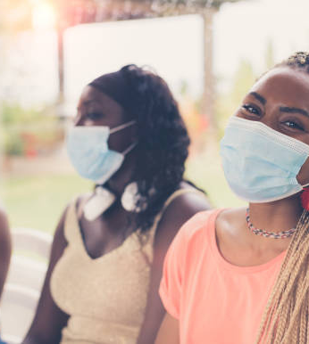




GROUP 4
TEAM MEMBERS
JEGEDE OLUWATOLA (joluwatola@outlook.com)
(TEAM LEAD)
ADEDAYO VICTORIA (adedayovicky123@gmail.com)
(ASSISTANT TEAM LEAD)
KAUSARA DAUDA
(kausaradauda@gmail.com)
AHMED FAWAIZAH
(ahmedfawaizah@gmail.com)
JESSICA OSUAGWU
(jessyosuagwu@gmail.com)
ADAEZE NWA GRACE
(adaezenwagrace@gmail.com)
2022
OUR WOMEN
WOMEN TECHSTERS
ANIMAUX TEAM
COHORT 2.O
01

Slide 3
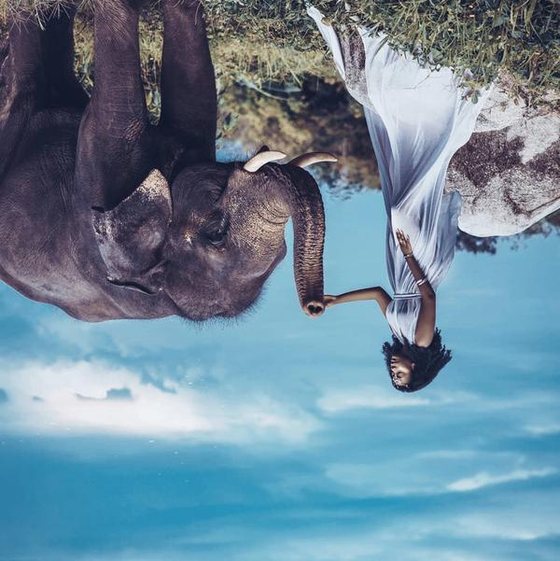
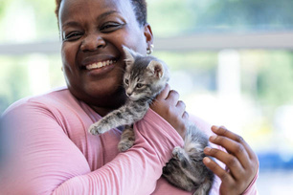
WELCOME TO
ANIMAUX TEAM
Animaux came about in 2022. A group of tech women in Africa came together to find a solution to Sustainable Development Goal 15. The Sustainable Development Goal 15 which is about Life on Land was established by the United nations in 2015 to help promote, restore and promote sustainable use of the ecosystem. We are on a mission to create a better world for animals and to end animal cruelty and suffering forever. At Animaux, we are committed to providing help for animals to thrive in a world where they can't actually speak for themselves. To feel loved and protected, to matter too.
Akanke Abimbola
Founder

Slide 4

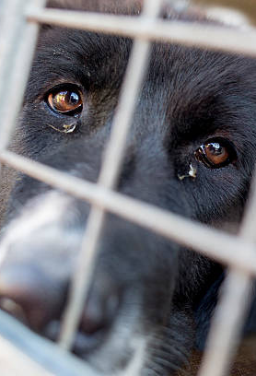


INTRODUCTION
Animal rights come into direct opposition with animal exploitation, which involves animals being used by humans as food, experimental objects or even pets.
This presentation will walk through what inspired our movement.
2022
Around the world, animals have been exploited, deliberately harmed and killed by humans because they have are seen as different, inferior and helpless.
Despite the fact that Human Right and Animal Right movements are distinct, a correlation still exists between the two movements; we both seek justice and fairness for being abused.
Animals should not be beaten, caged, artificially inseminated,trapped, traded, harmed and killed at someone else's gain.
ANIMAUX TEAM

Slide 5
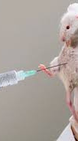
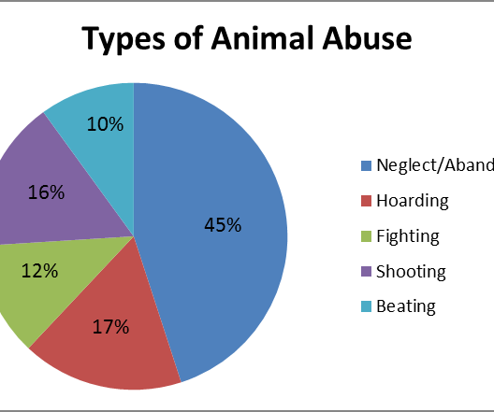
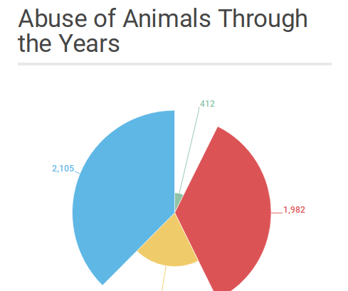
STATISTICS
According to the African Welfare Society (AWS) in 2021, over the last 3 years, an average of 249 animal cruelty cases occured monthly. Some of the worst cases the AWS has seen include dogs with chains embedded in their necks, grossly emaciated cats and dogs, gunshot victims, and stabbed animals. This is on the rise as of 2022.
2022
Thousands of animal abuse cases are reported every day. However, animal abuse statistics reveal that most animal and pet abuse cases are never brought to light.
Every 60 seconds, one animal suffers abuse
Close to 65% of all abused animals are dogs
On average, 250,000 animals every year are victims of animal hoarding.
More than 115 million animals are used for laboratory experiments yearly.
An estimated 1.6 trillion wild animals are killed by humans every year.
ANIMAUX TEAM

Slide 6
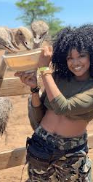

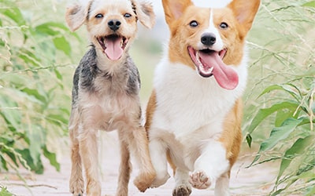
ANIMALS CAN EXPERIENCE PHYSICAL AND PSYCHOLOGICAL PAIN. THIS IS
WHY WE SEEK...
BETTER LAWS
Implementation of laws based on an animal rights philosophy would see an end to conventional animal farming and other practices, in which animals are exploited for human benefits.
2022
A BETTER LIFE
ANIMAUX TEAM
To rescue the mistreated, save the injured, love the abandoned and bring awareness about a better understanding of where animals can be beneficial in our lives.

Slide 7
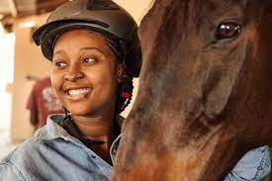
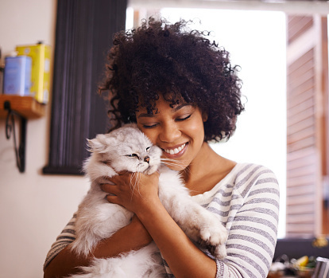

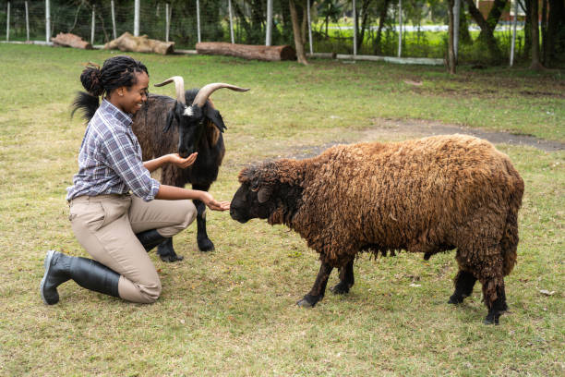


VISION 1
We at Animaux seek to create a world where animals live free from unjust suffering so that we can move the world of animals and make the world a lot kinder to them.
VISION 2
VISION 3
We want to be agents of sustainable change across the globe as regards saving stray animals, animals undergoing cruelty, malnutrition and other harmful vices.
We are cutting off dangers so we can see our ecosystem safe for life by providing a means to the end of threat on the life of animals round the globe and our environment.

Slide 8

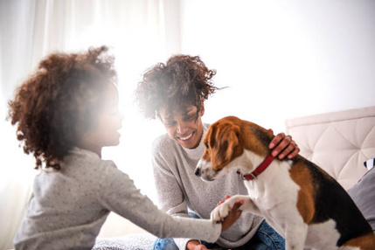
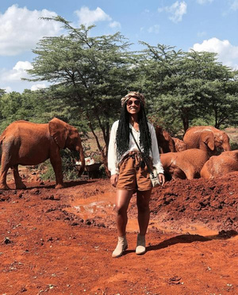
OUR MISSION STATEMENTS
To be an organization committed to continually effecting positive change at every point in time and as well helping the world be a better place each moment at a time.
To see to the sustainability of animal life all round by providing rescue services, foster care and adoption in order to ensure animals are well placed in homes or our shelters.
To rescue the mistreated, save the injured, love the abandoned and bring awareness about a better understanding of where animals can be beneficial in our lives.
MISSION 1
MISSION 2
MISSION 3

Slide 9
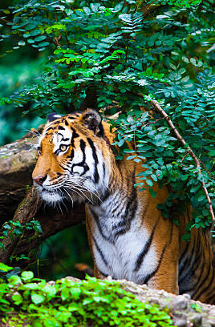






OUR SERVICES
ANIMAL RESCUE
PROTEST CAMPAIGN
We are available across various African countries to provide emergency rescue and shelter to these animals being abused.
We carry out protest campaigns across various communities in Africa to sensitize and educate them on the need to stop animal cruelty in their homes and in the society at large.
PUBLIC EDUCATION
SHELTERING FOR ANIMALS
We carry out widespread public education projects and programs to various parts of Africa to ensure animal cruelty becomes a thing of the past.
We ensure animals are in very suitable homes, either at our shelter or at the homes of people who willingly adopt them. We also ensure follow-up actions take place to ensure there is no abuse of any form.
LEGAL AND INVESTIGATIVE ASSISTANCE
24/7 INVESTIGATIVE AND REPORTING SERVICE
We carry out advocacies and try to seek better legislative laws that respect animal rights. We also carry out investigative actions on where animal abuse is occuring.
At any time there is a need to call us, our lines are available 24/7 to respond to the rescue call of animals being abused.

Slide 10


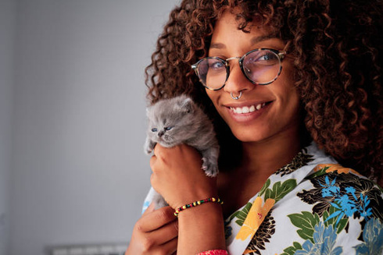
MEET OUR TEAM
AKANKE ABIMBOLA
KIGATI SHEBA
KATE GLOVER
FOUNDER/CEO
CHIEF EXECUTIVE
DOCTOR
Abimbola is a Social Worker who envisoned a team of African sisters coming together to birth the Animaux Team dream. She has grown up in a society where animals are killed with impunity and decided to change the narrative for Africa to become a better place.
Sheba is a lawyer who works hand-in-hand with Mbappe Lilly, the team's resident lawyer, in drafting out strategies for impacting le legislative arm of government to create policies that are postive for animals. She handles all executive affairs too.
Kate is an animal doctor who focuses on the health of animals. She supervises the medical team in ensuring animals that are rescued are taken care of and in perfect health condition in order to prevent death. She is highly passionate about their survival.

Slide 11
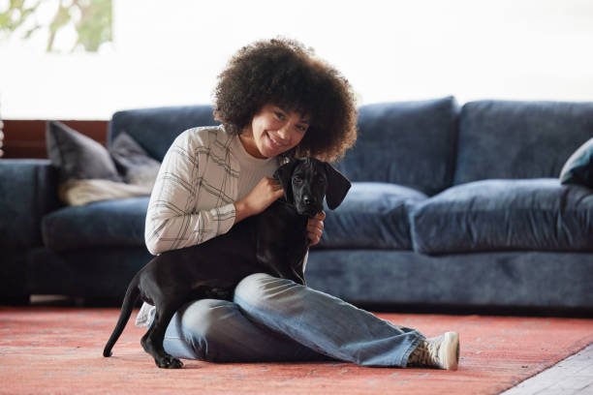


GET IN TOUCH
We are present in over 8 African countries.
123 Street, Lagos, Nigeria
456 Street, Accra, Ghana
789 Street, Dakar, Senegal
123 Street, Lome, Togo
321 Street, Cairo, Egypt
419 Street, Addis Ababa, Ethiopia
920 Street, Nairobi, Kenya
440 Street, Kampala, Uganda
+234 345 67890
+233 345 67890
+221 345 67890
+228 345 67890
+20 345 67890
+251 345 67890
+254 345 67890
+256 345 67890
lifeonland@emaill.com
www.animauxteam.com

Slide 12

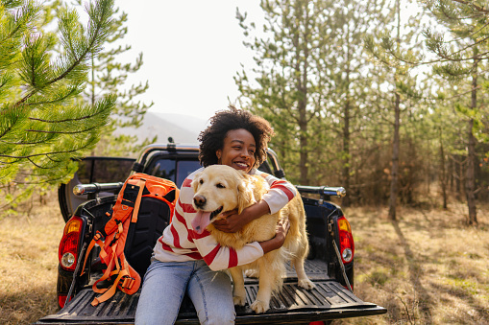
MOVEMENT
Thank You!
RIGHT
ANIMAL
We call on you to please join our movement. Animals, just as humans, should have a right to life, safety and protection. Let us put an end to endangering animals for any reason at all.
Join our clan today!
AN

